Slide 1

Management information system in barangay new pandan, panabo city

Slide 2
INTRODUCTION
Background of the Study
Barangay New Pandan, located in Panabo City, Davao del Norte, is a vibrant community comprising a diverse population. As with many barangays in the Philippines, New Pandan faces the challenge of managing various administrative tasks, maintaining accurate records, and providing efficient services to its residents. The current manual system of managing barangay operations, relying heavily on paper-based documentation and traditional communication methods, has proven to be time-consuming, prone to errors, and inefficient in meeting the growing demands of the community.

Slide 3
Objectives of the Study
General Objective:
The general objective of this study is to develop and implement a Management Information System (MIS) in Barangay New Pandan, Panabo City, to improve administrative processes, enhance service delivery, and promote efficient governance.
General Objective:

Slide 4
Specific Objectives:
To design and develop a web-based MIS that encompasses essential modules for resident profiling, purok leader, barangay officials' management, document management, announcement feature, logs, and reporting functionalities:
To establish a centralized database for efficient data collection, storage, retrieval, and analysis within the MIS:
To evaluate the usability, functionality, and performance of the developed MIS through user testing and feedback:
4. To ensure data security and privacy within the MIS by implementing appropriate access controls and encryption measures:
5. To empower residents with up-to-date information on barangay announcements, events, and initiatives through the MIS.

Slide 5

Scope and Delimitations
Scope:
Resident Profiling
Document Management
Purok Leader
Announcement Features
Household
Blotter Report
Report
Logs
System Settings
Logout

Slide 6
Delimitations:
While this capstone project aims to address key challenges in barangay management, it is important to recognize its limitations and delimitations, which include:
Residents who are not duly registered in the system database can neither file complaints nor request documents;
Residents with no available internet connection cannot access the online barangay services, hence all requests and complaints in that case must be filed personally at the barangay office;
The system can only be accessed by system users as authorized by the system administrator.
The project assumes the availability of basic hardware (computers, servers) and a stable network infrastructure to support the implementation of the web-based MIS. However, detailed infrastructure setup is beyond the scope of this project.
While the project acknowledges the importance of data security, it focuses primarily on implementing basic access controls and encryption measures within the MIS. Advanced security measures, such as penetration testing or advanced encryption algorithms, may not be included.

Slide 7
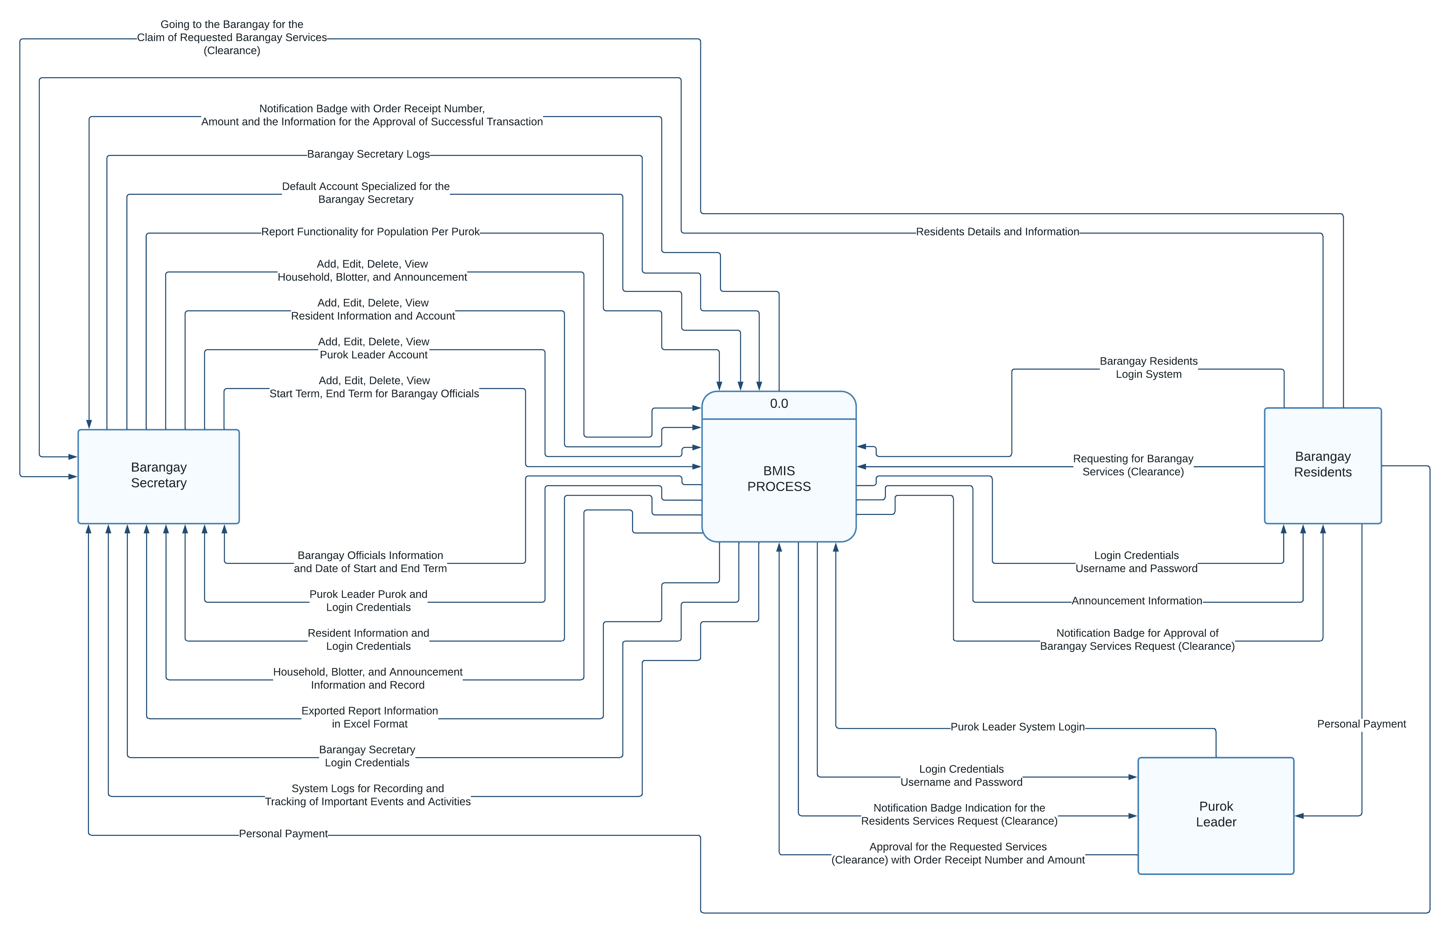
Concept of the Study

Slide 8
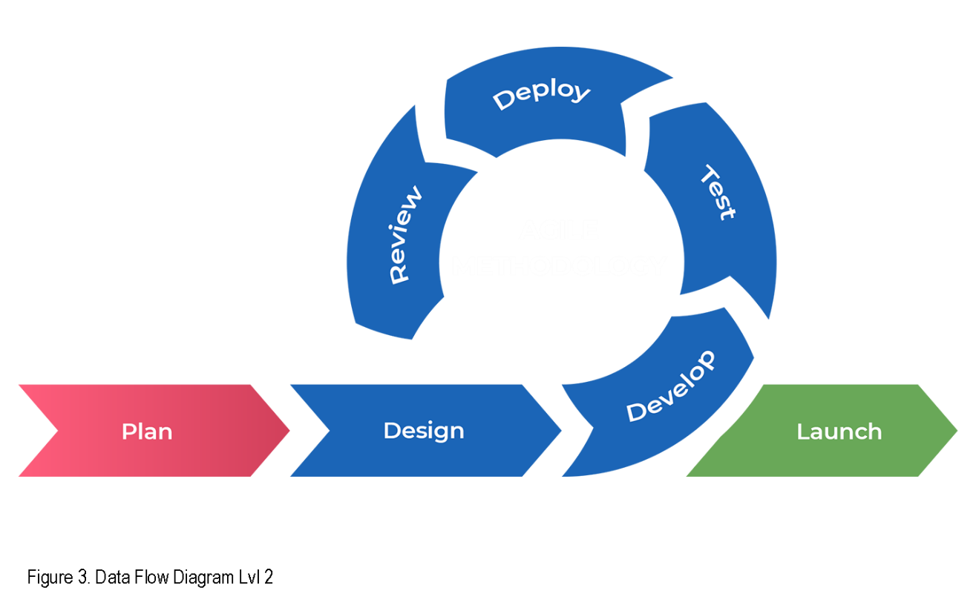
Methods

Slide 9

Figure 1: Secretary Login Page

Slide 10
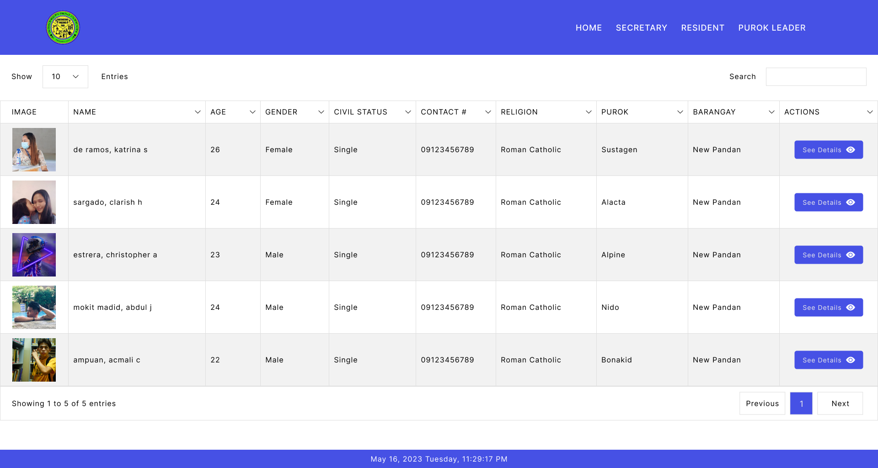
Amenities image
Figure 2: Homepage

Slide 11
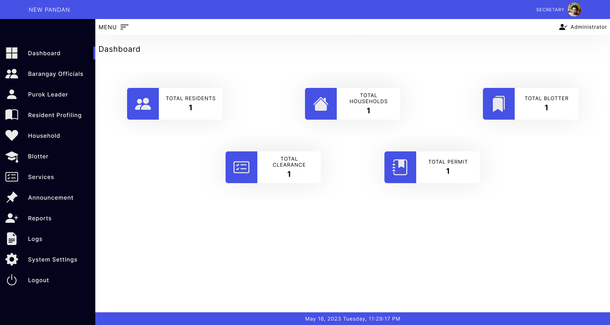
Figure 3: Dashboard

Slide 12
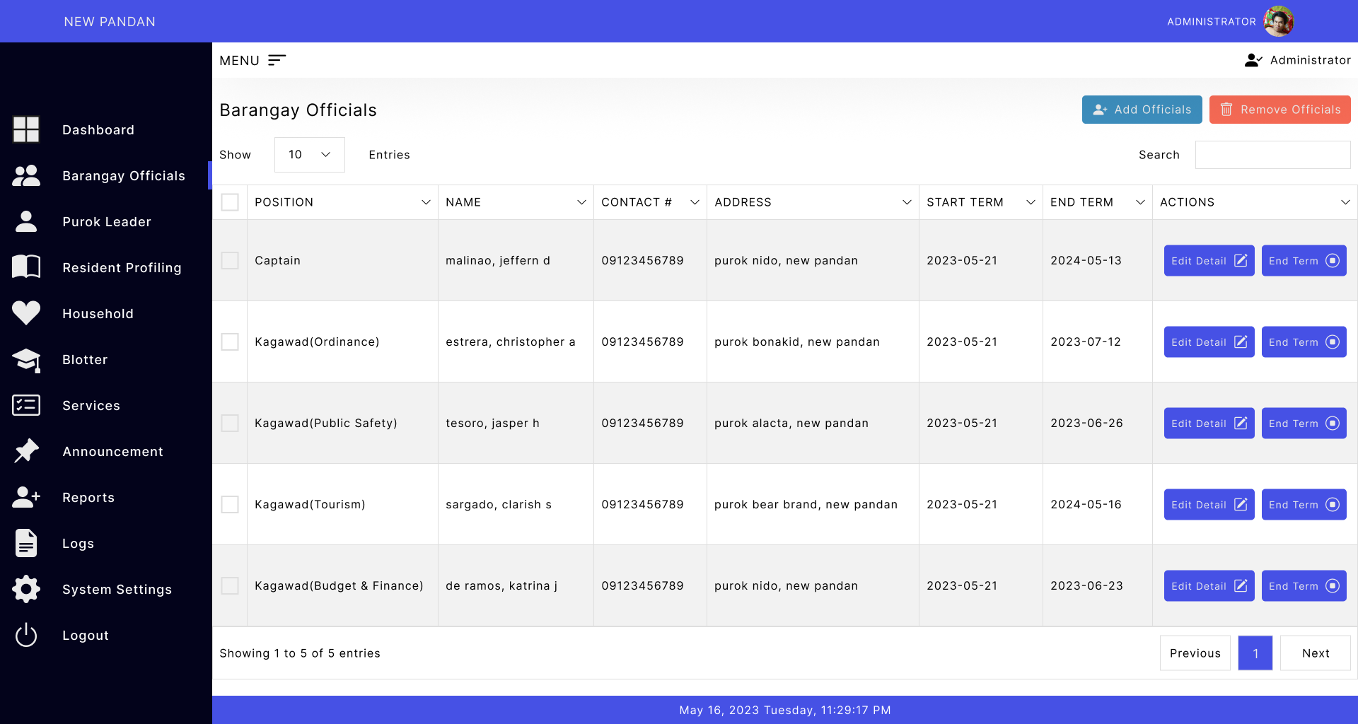
Figure 4: Barangay Officials

Slide 13
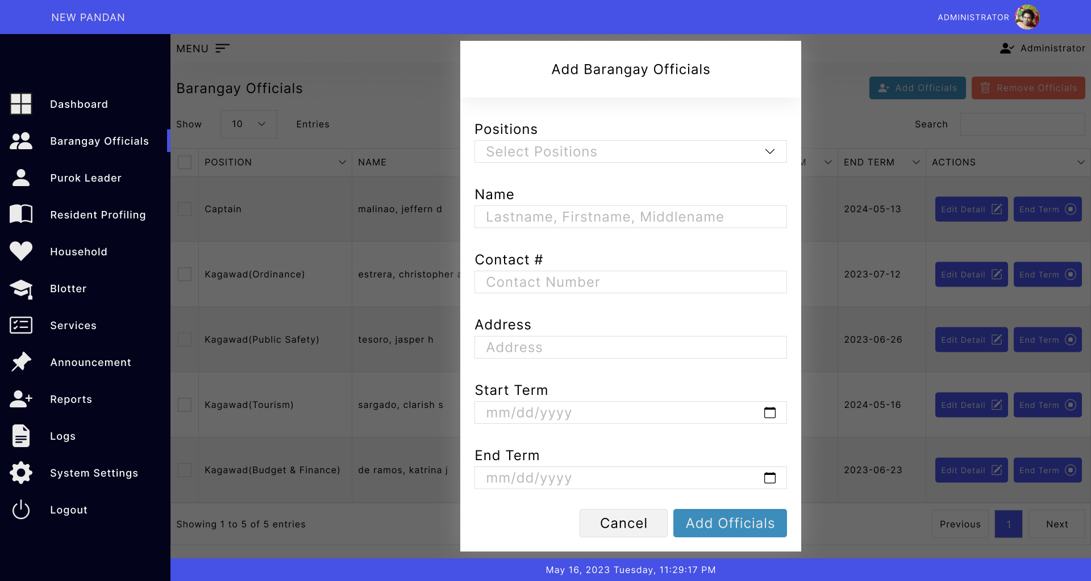
Figure 5: Barangay Officials (Add Officials)

Slide 14
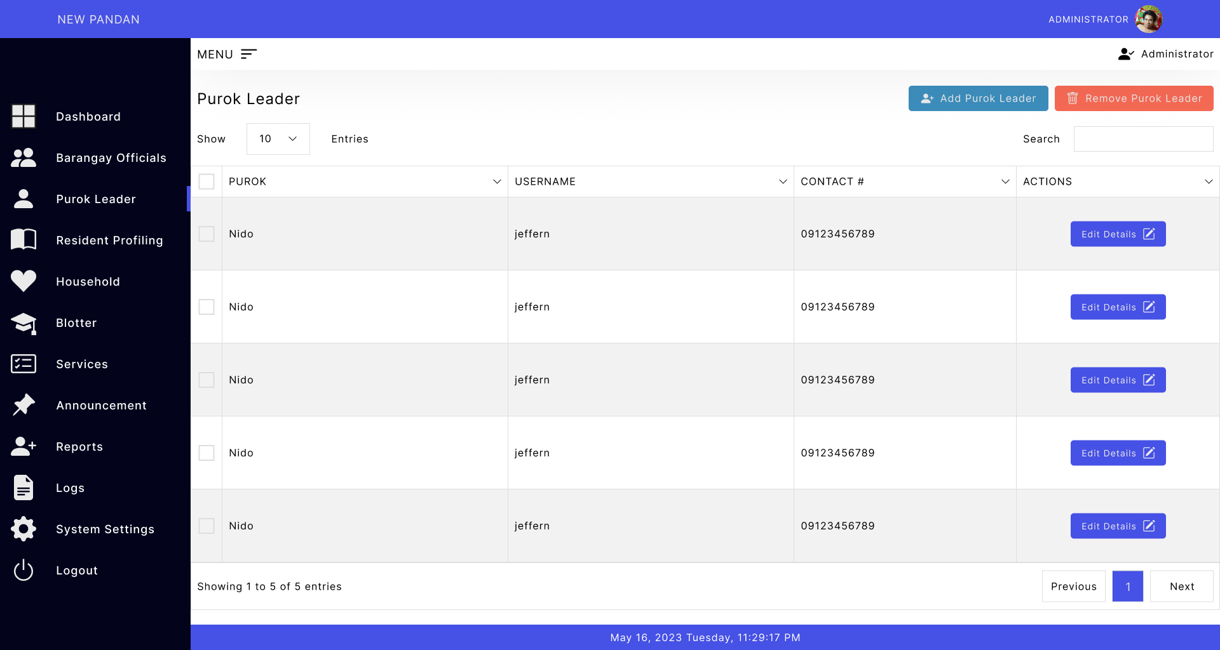
Figure 6: Purok Leader

Slide 15
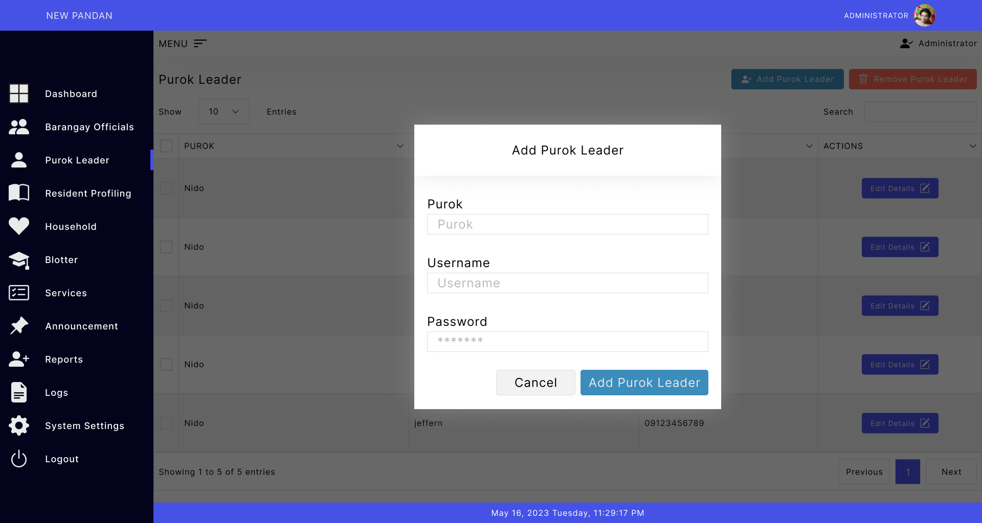
Figure 7: Purok Leader (Add Purok Leader)

Slide 16
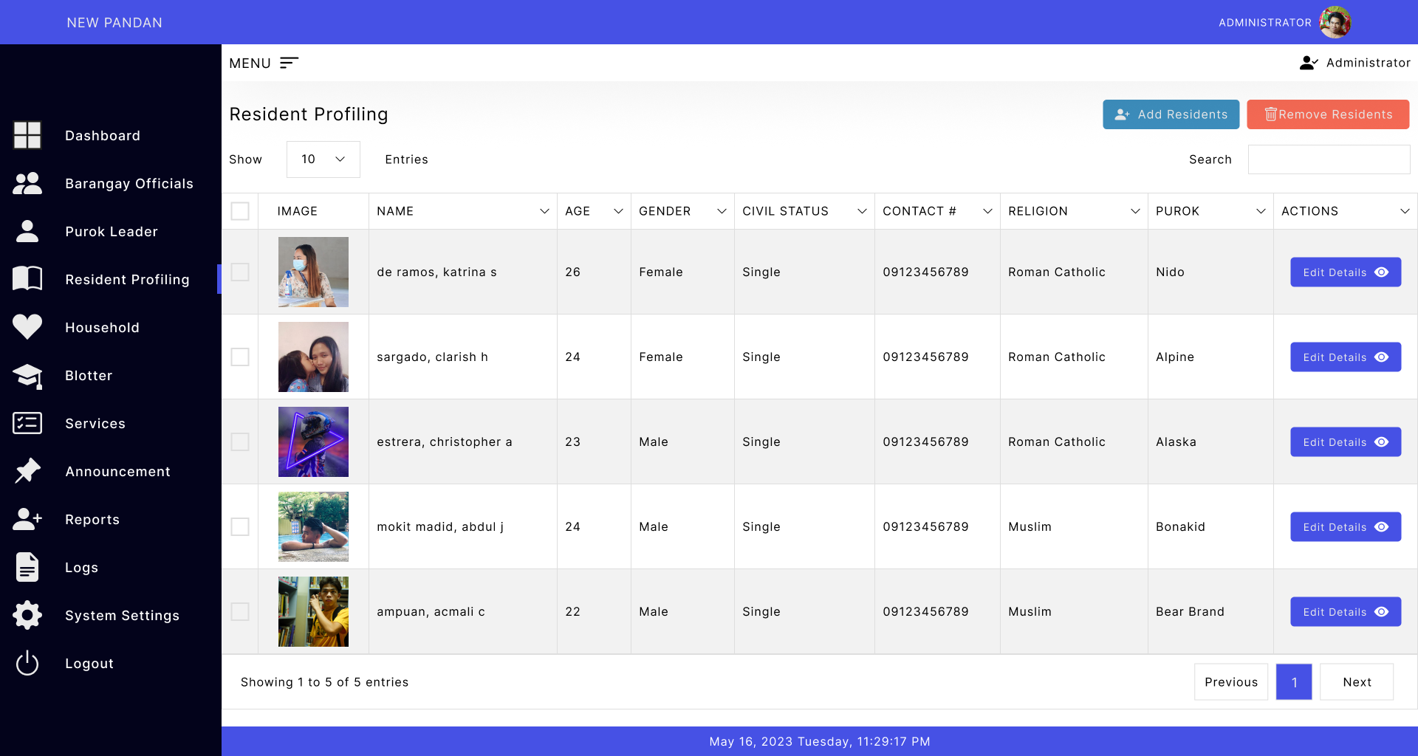
Figure 8: Resident Profiling

Slide 17
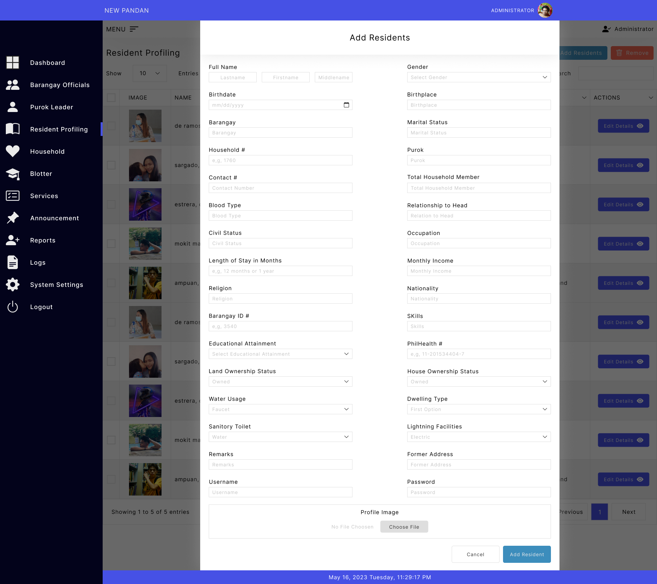
Figure 9: Resident Profiling (Add Residents)

Slide 18
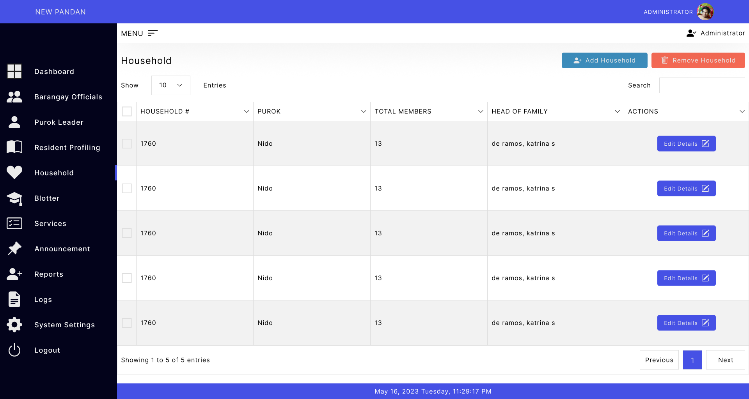
Figure 10: Household

Slide 19
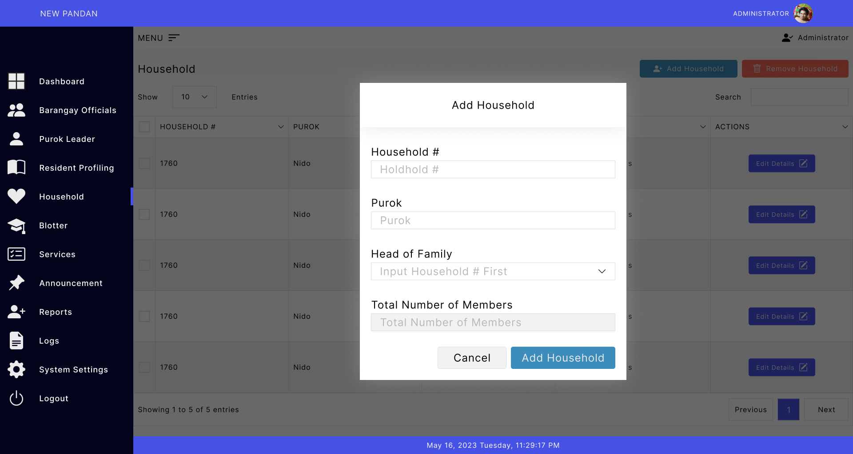
Figure 11: Household (Add Household)

Slide 20
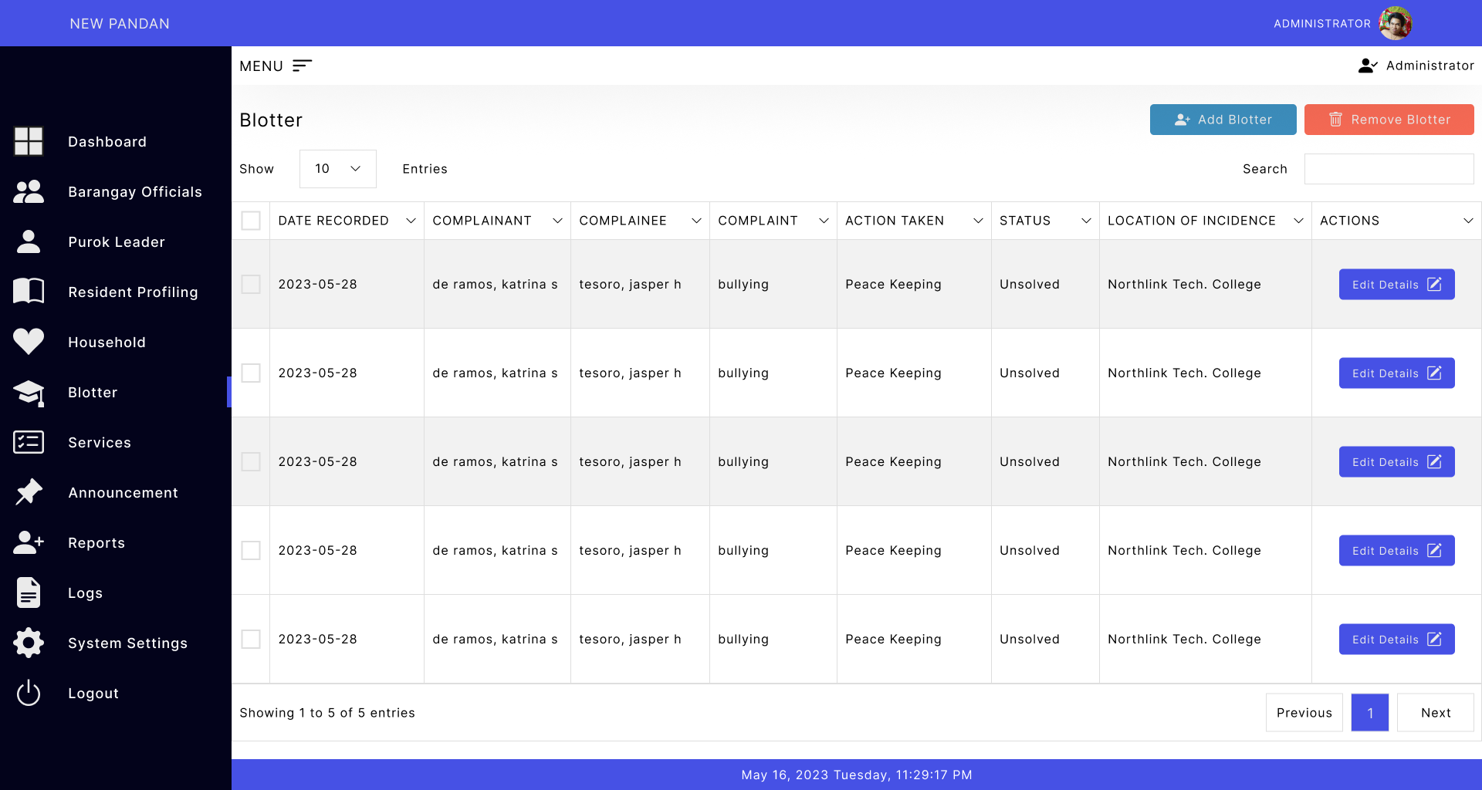
Figure 12: Blotter

Slide 21
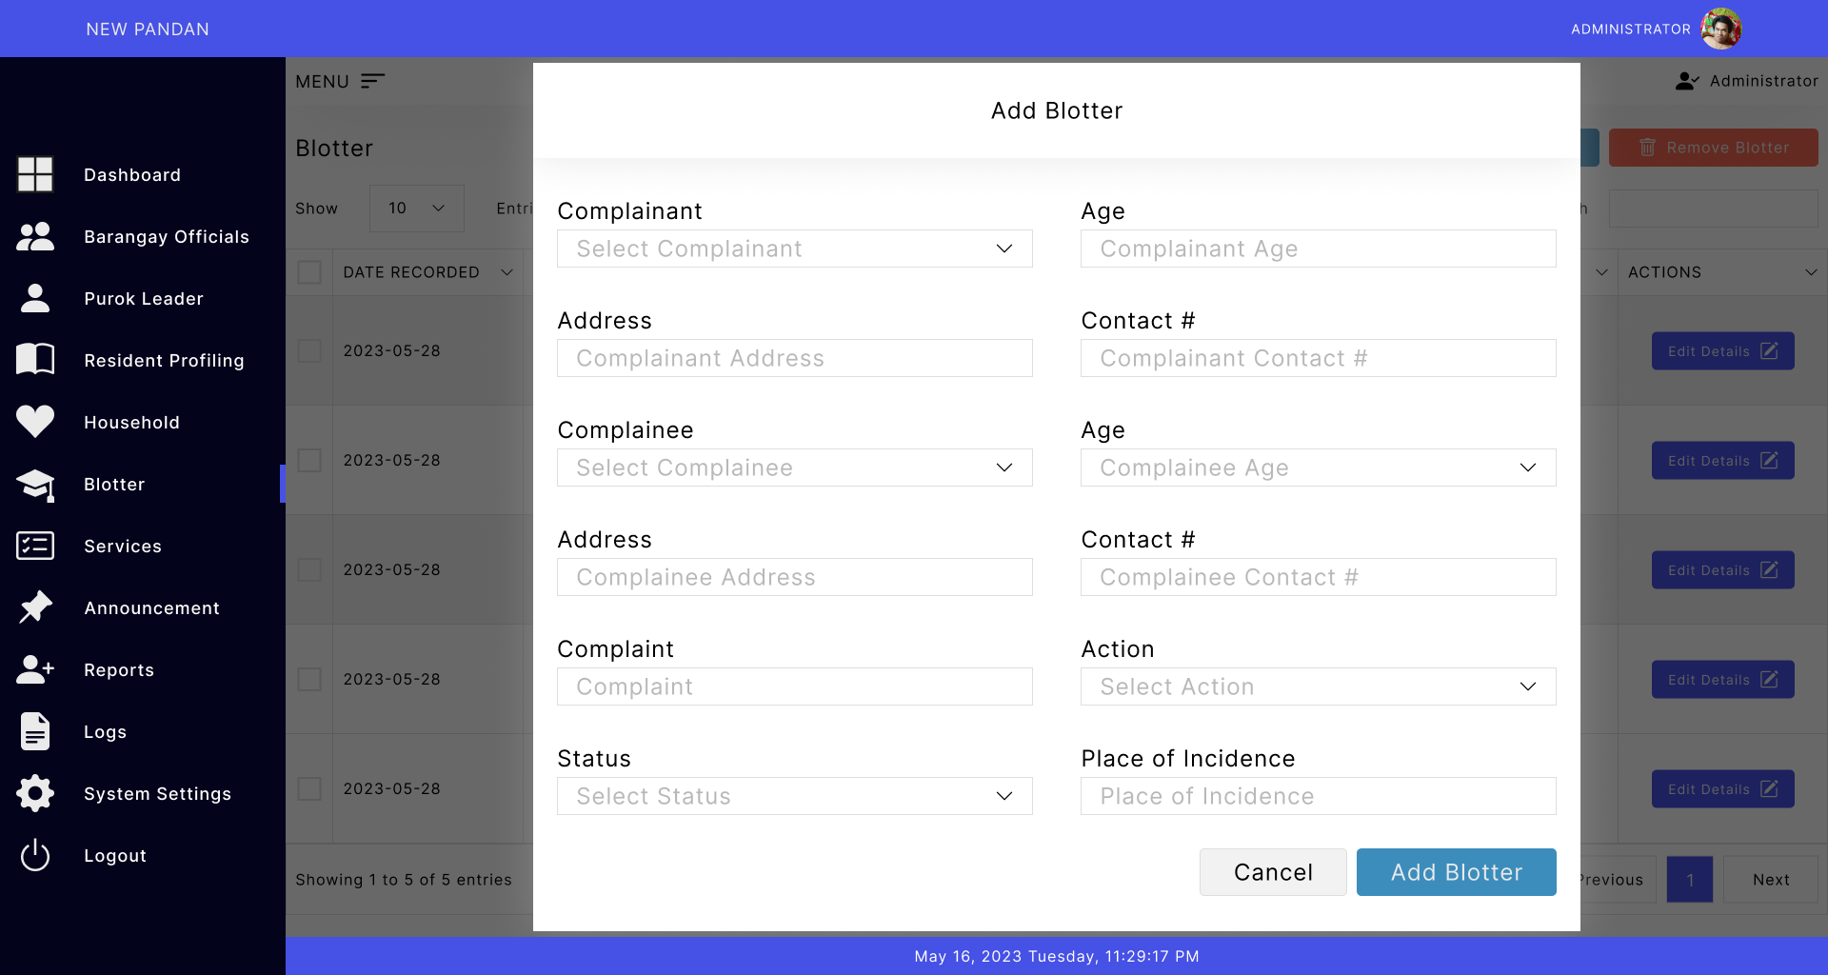
Figure 13: Blotter (Add Blotter)

Slide 22
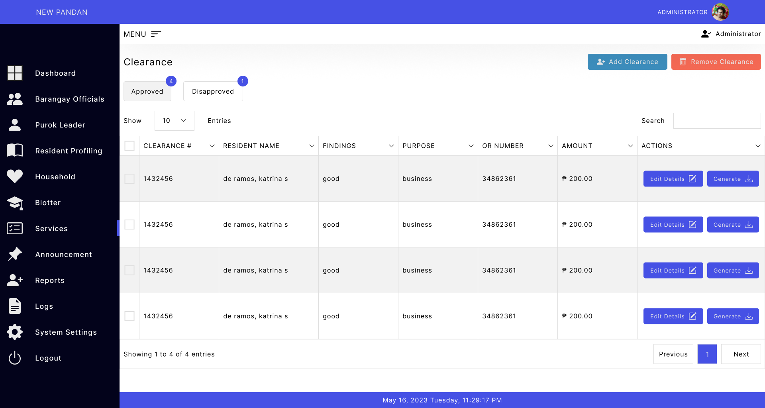
Figure 14: Clearance

Slide 23
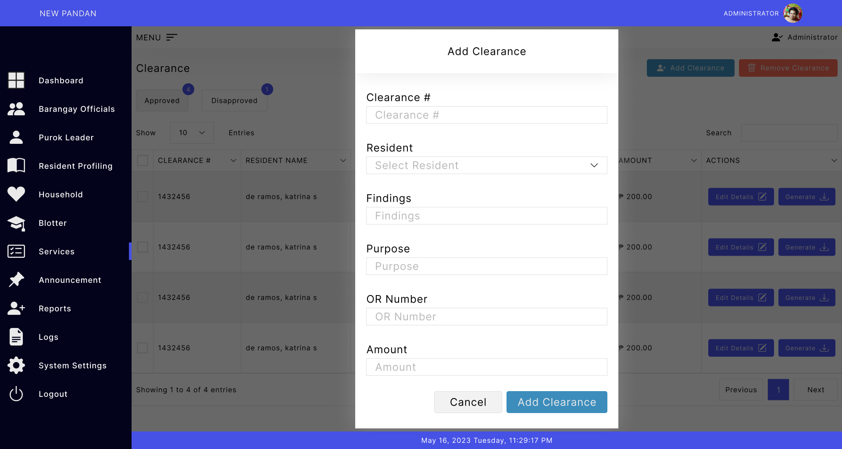
Figure 15: Clearance (Add Clearance)

Slide 24
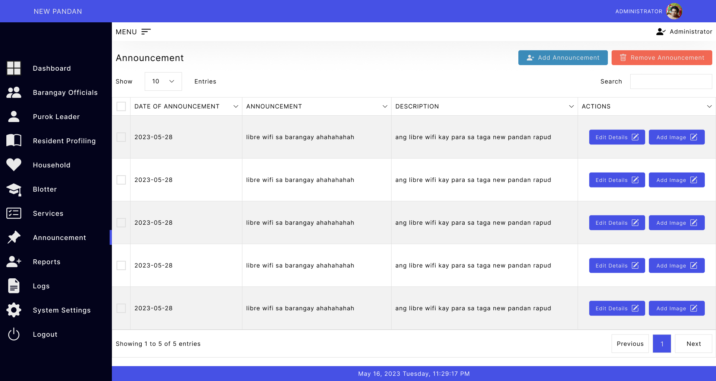
Figure 16: Announcement

Slide 25
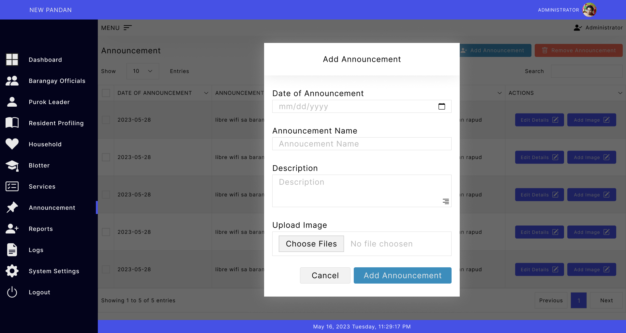
Figure 17: Announcement (Add Announcement)

Slide 26
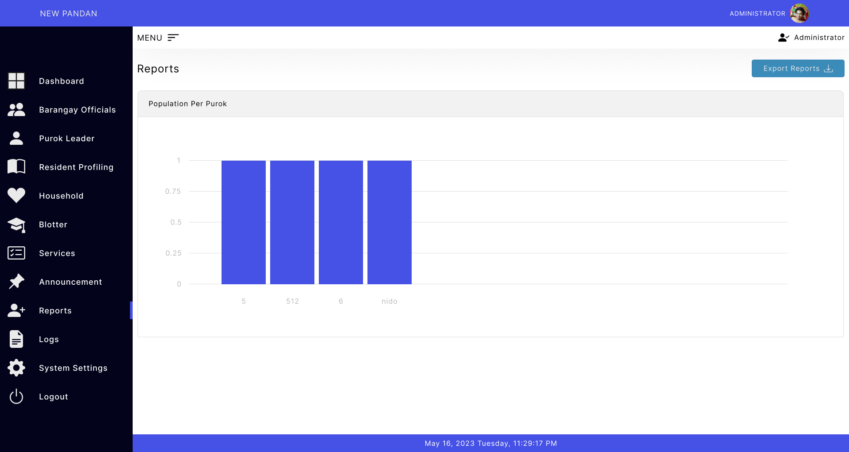
Figure 18: Report

Slide 27
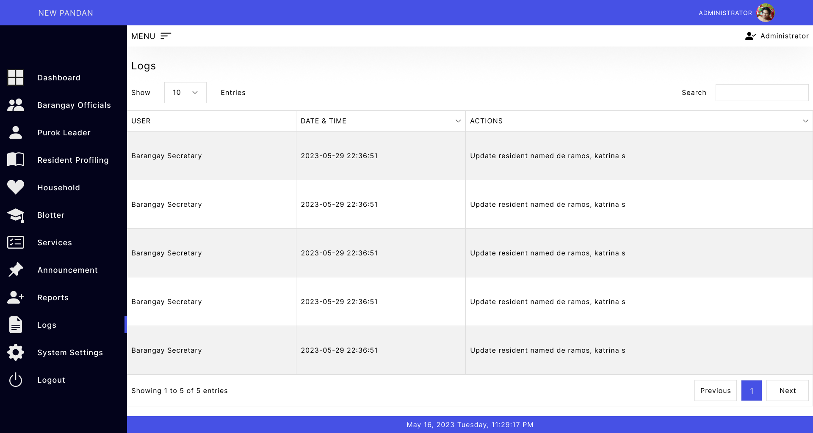
Figure 19: Logs

Slide 28
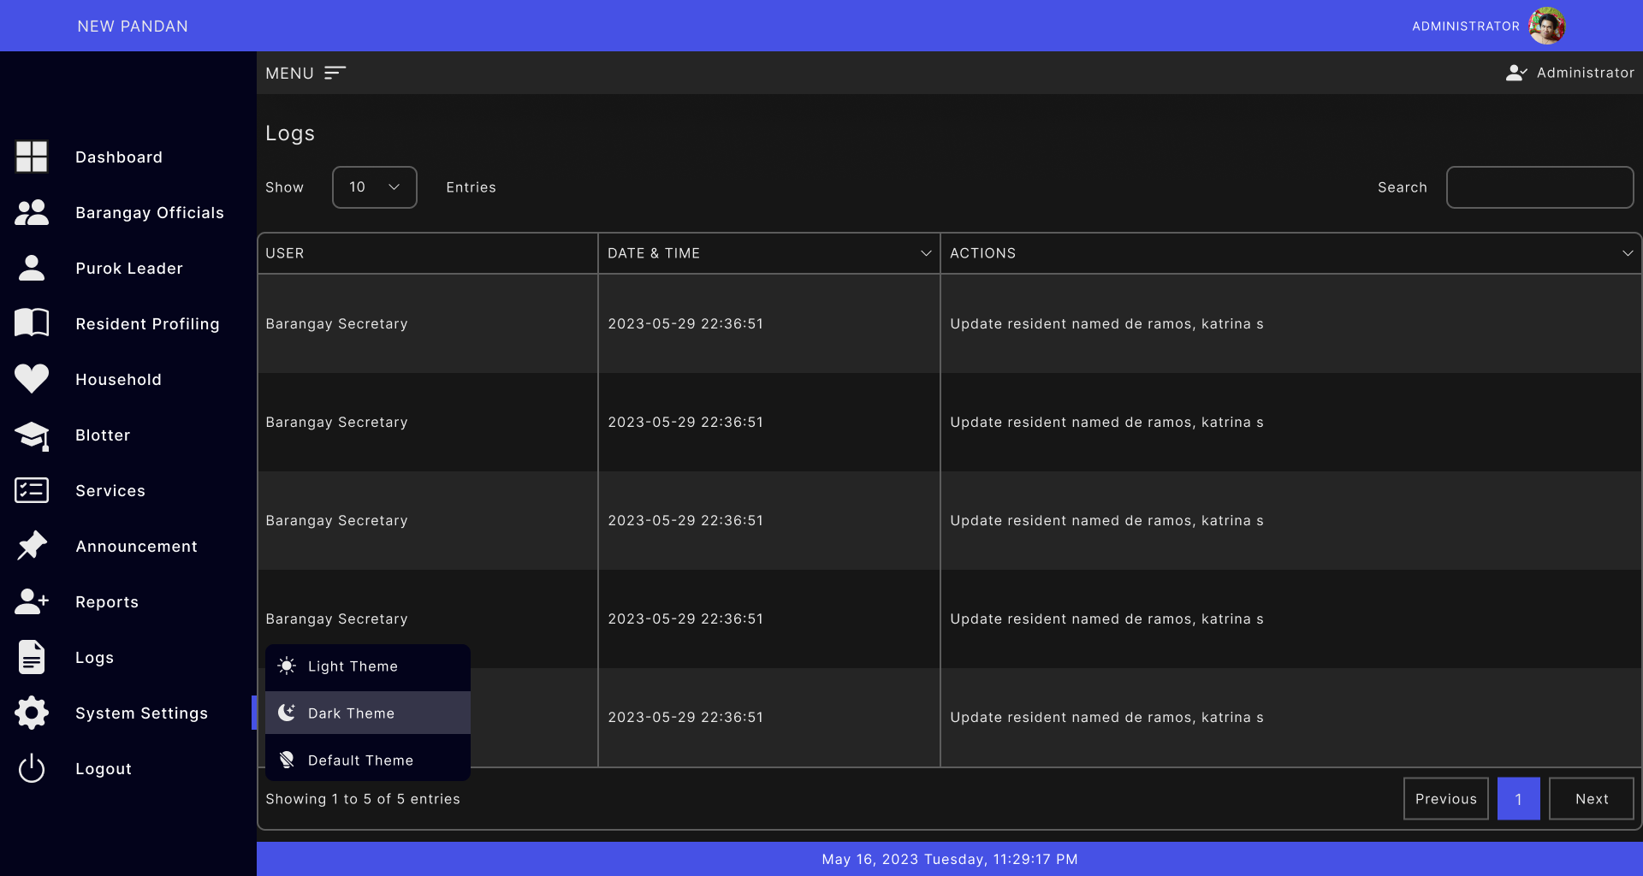
Figure 20: System Settings (Dark Theme)

Slide 29
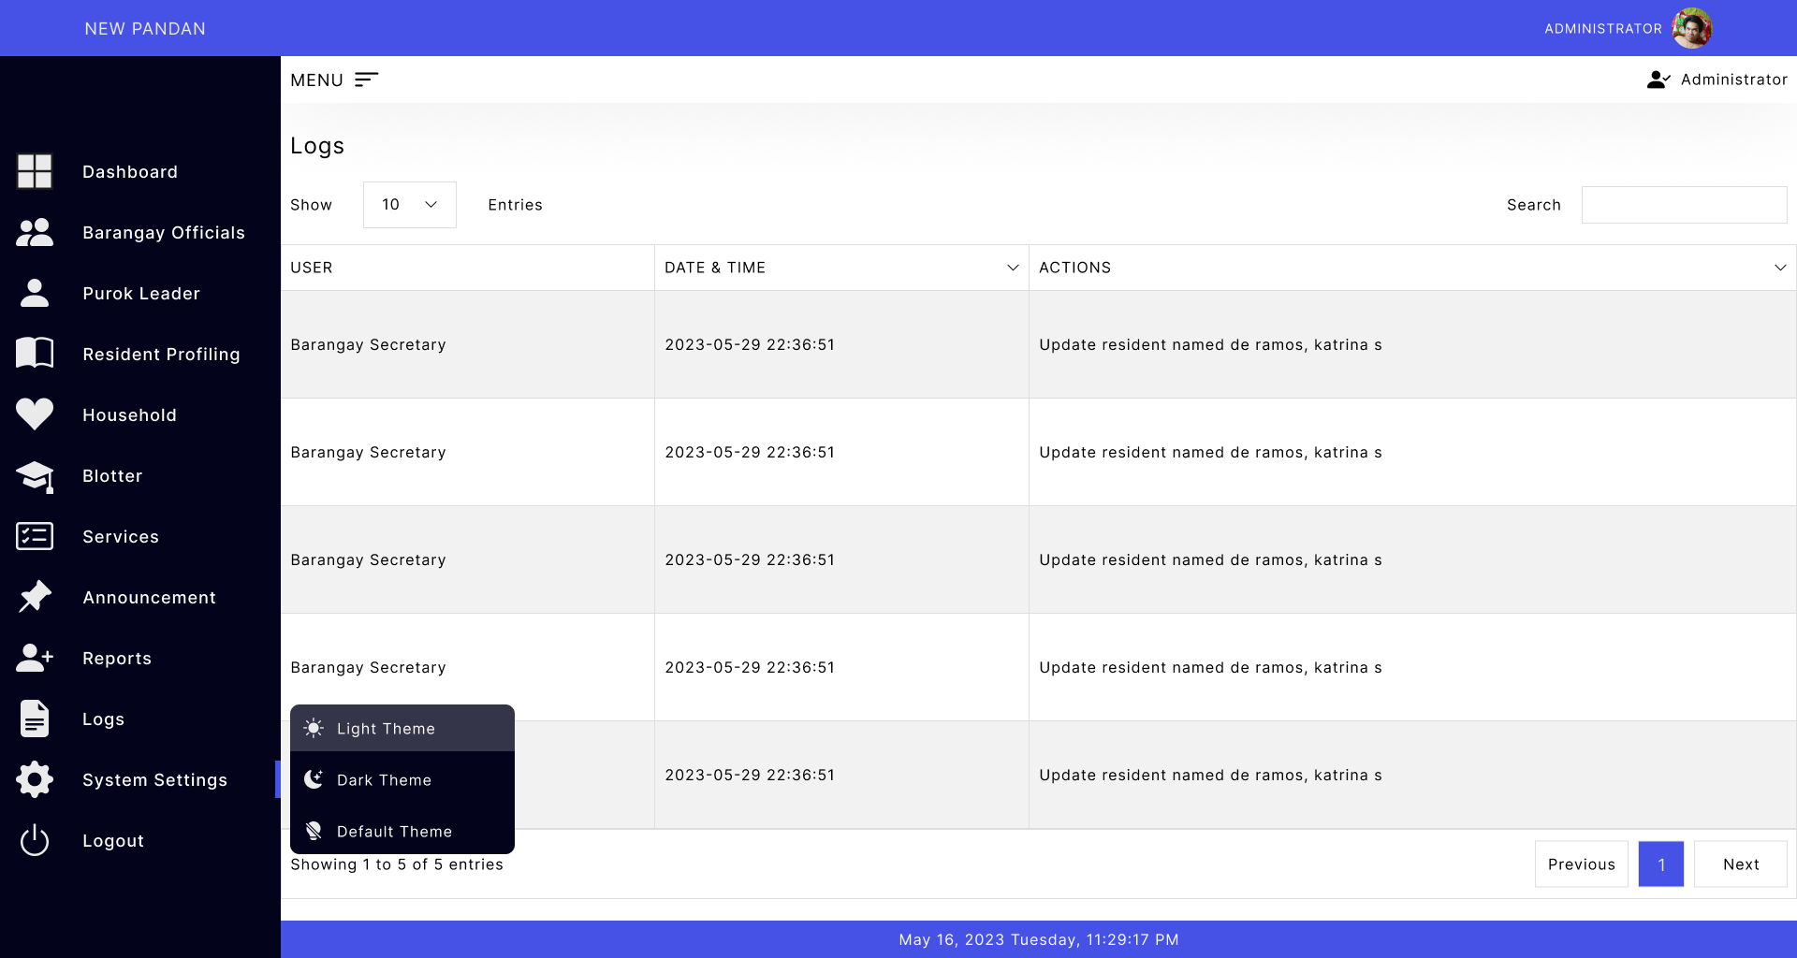
Figure 21: System Settings (Light Theme)

Slide 30
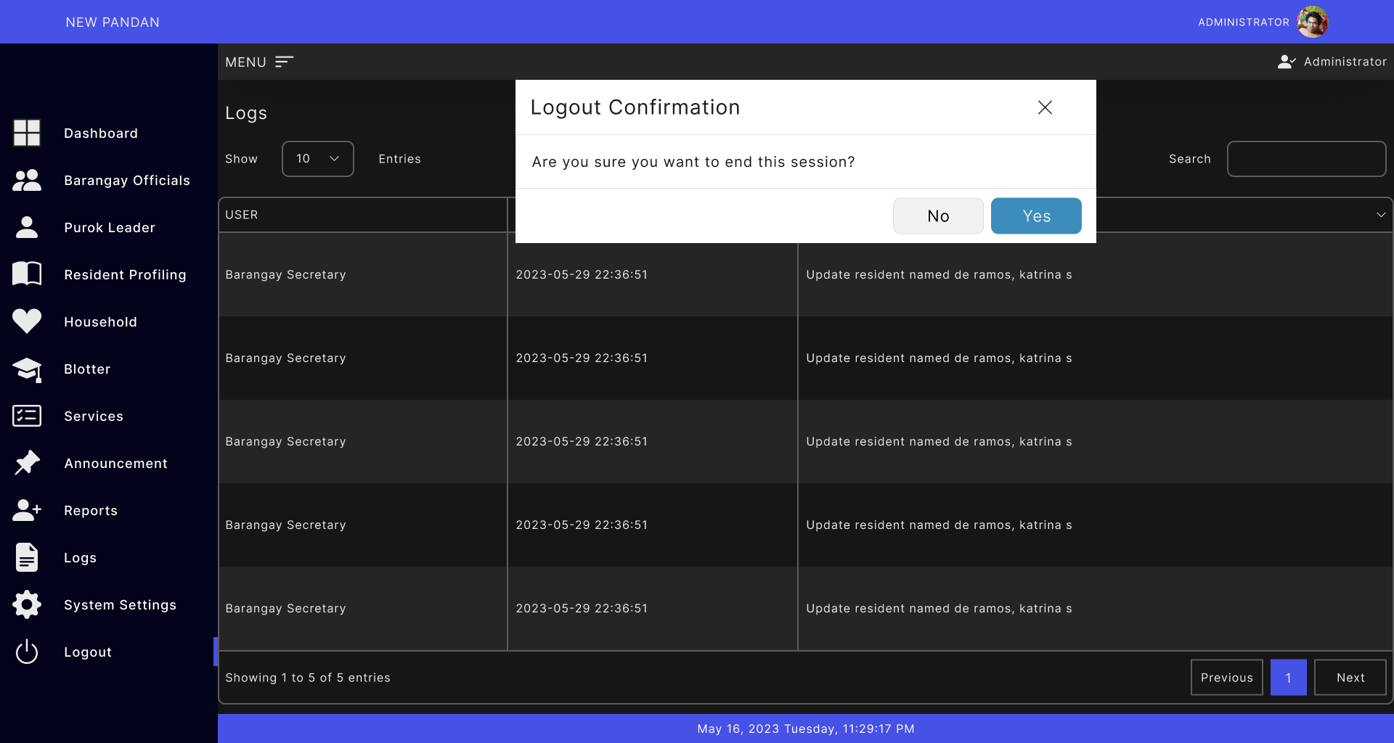
Figure 22: Logout

Slide 31
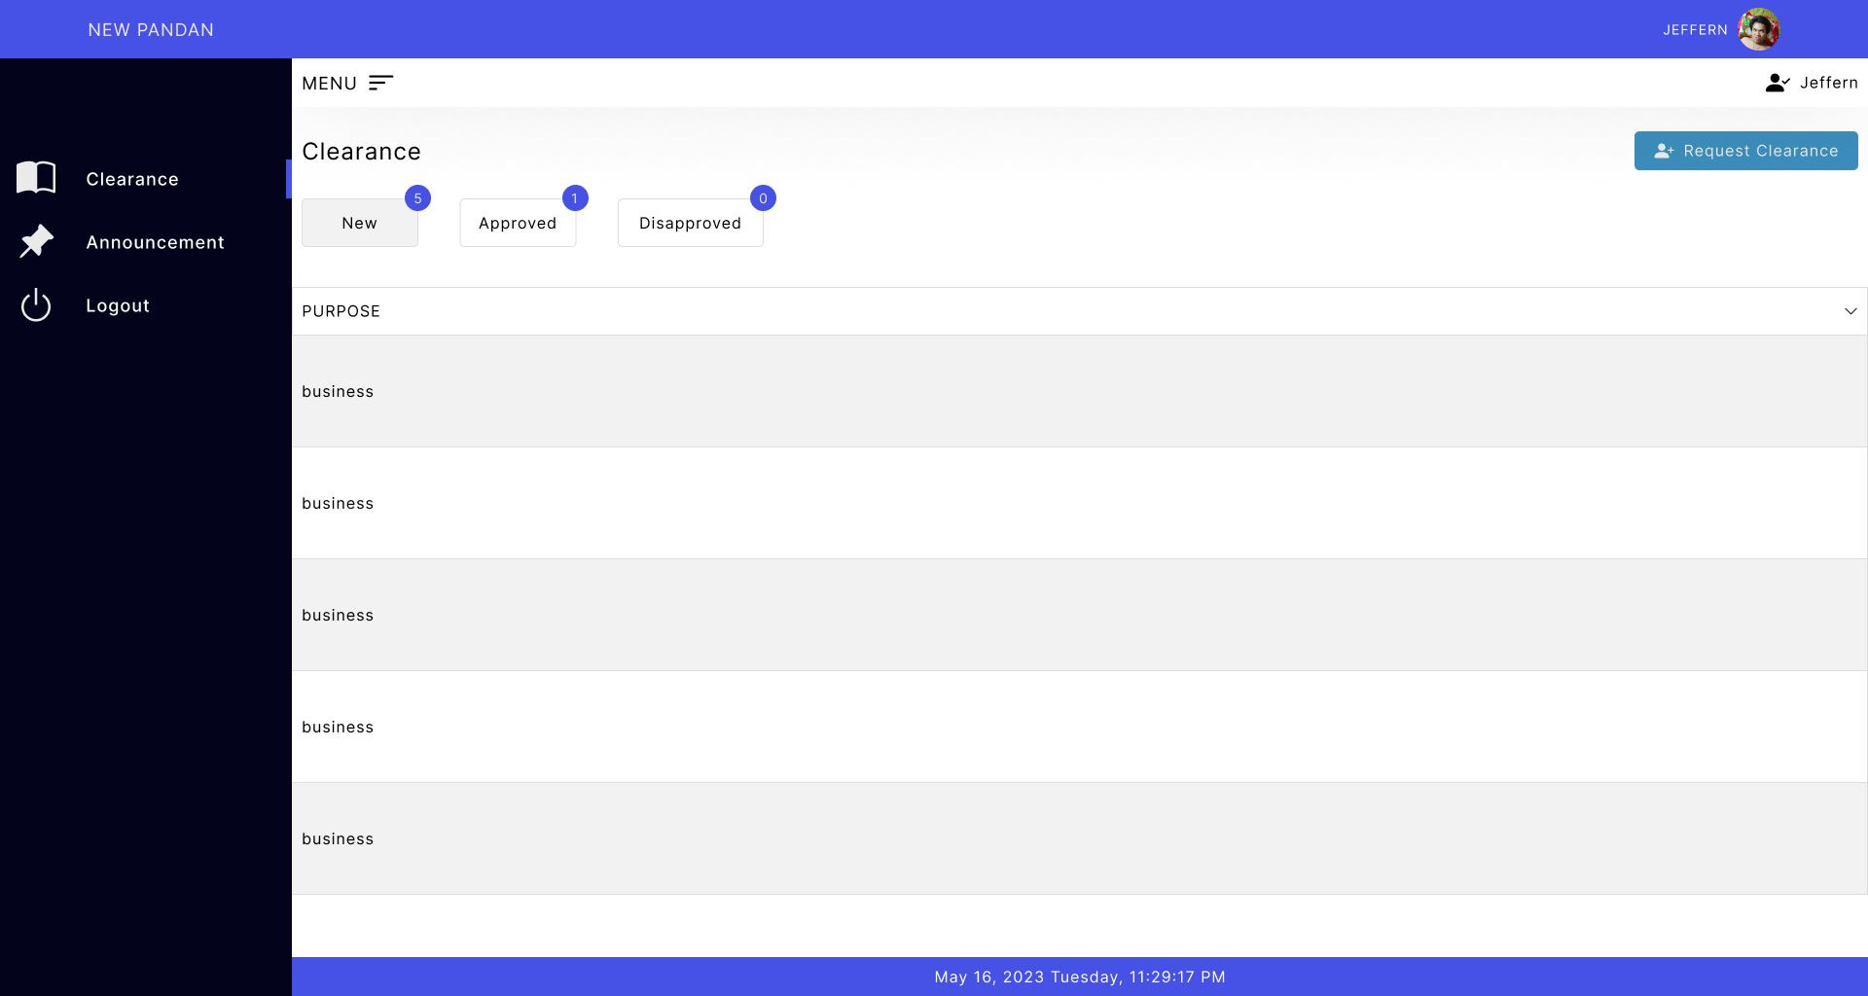
Figure 23: Resident Account (New Clearance Request)

Slide 32
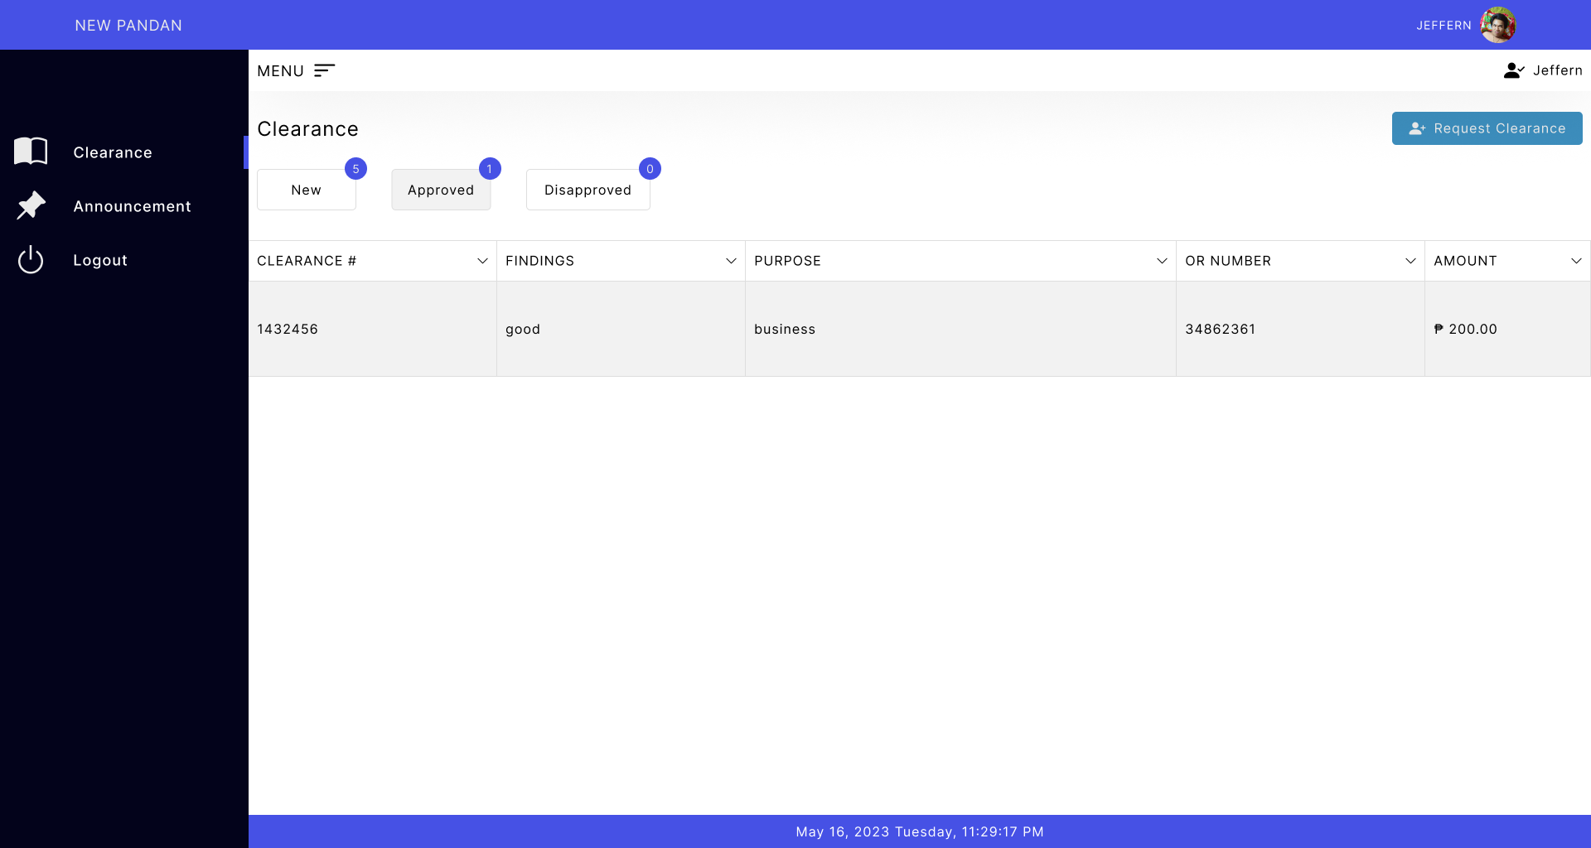
Figure 24: Resident Account (Approved Clearance Request)

Slide 33
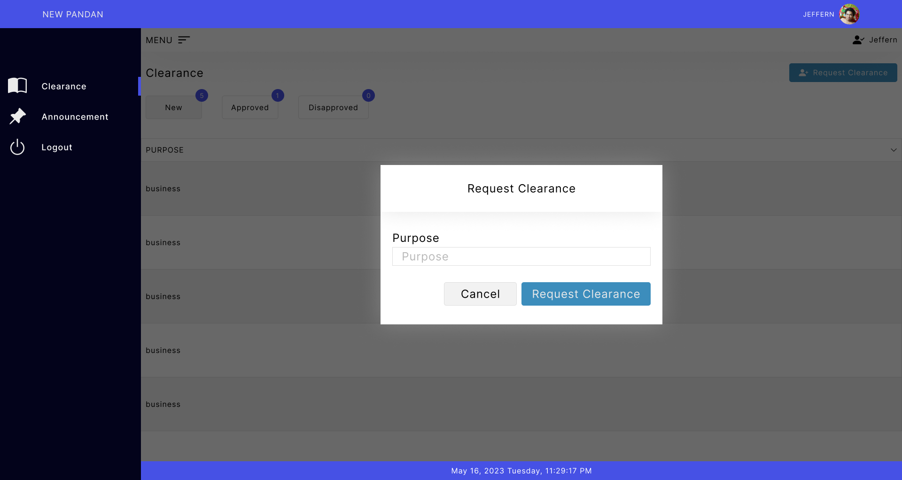
Figure 25: Resident Account (Request Clearance)

Slide 34
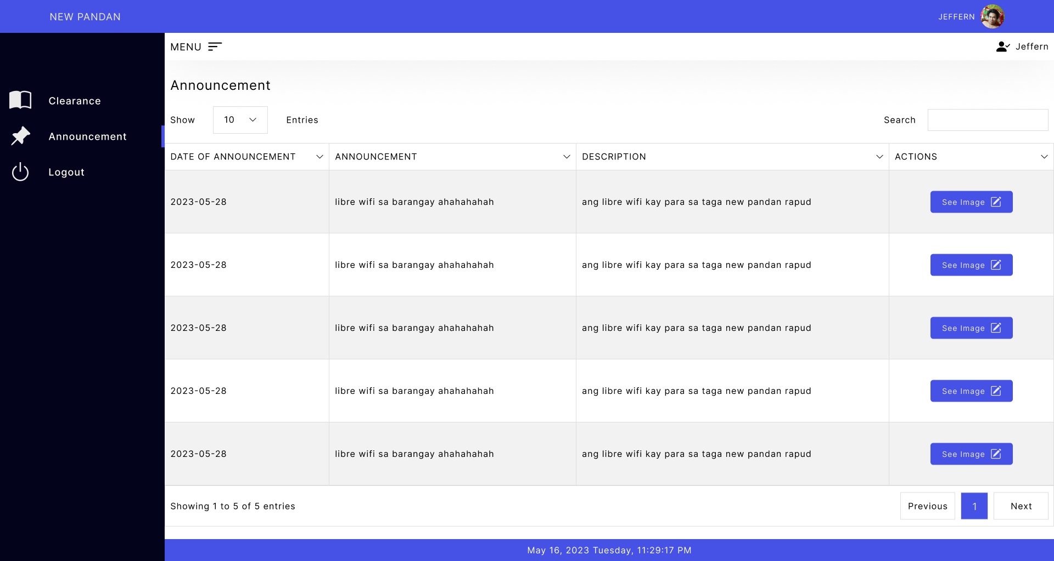
Figure 26: Resident Account (Announcement)

Slide 35
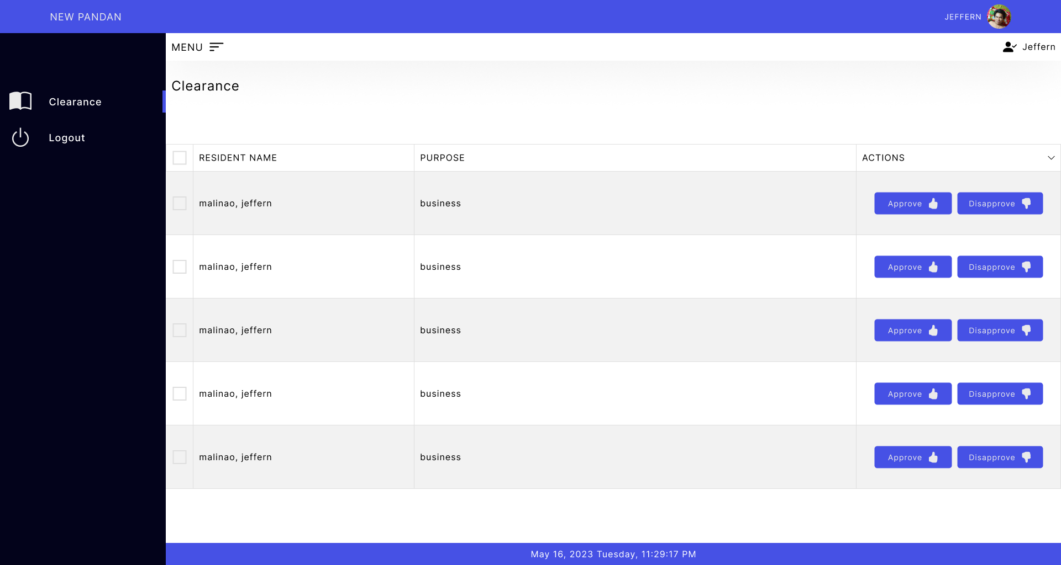
Figure 27: Purok Leader (Clearance Request List)

Slide 36
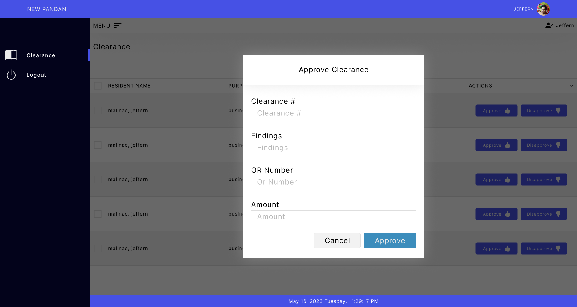
Figure 28: Purok Leader (Clearance Request Approval)

Slide 37
THANK YOU !!

